Slide 1

Understanding Android Notification
Using Android Studio
JULY 2024 SEMINAR
AFZAL BIRAJ SHERLIN EMMANUEL

Slide 2
01 - What are notifications?
02 - Parts of a notification
03 - High-Priority Notification
04 - Low-Priority Notification

Slide 3
01 - What are Notifications ?
A notification is a message displayed outside your app's normal UI, appearing as an icon in the notification area.
To see details, the user opens the notification drawer, both of which are managed by the system and can be viewed anytime.

Slide 4
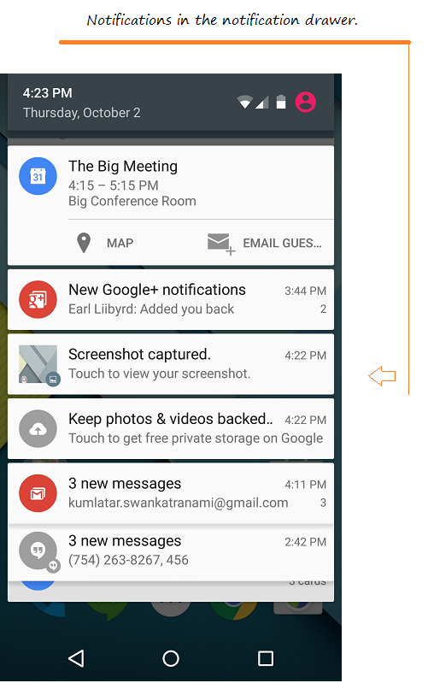
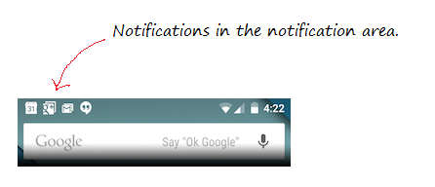

Slide 5
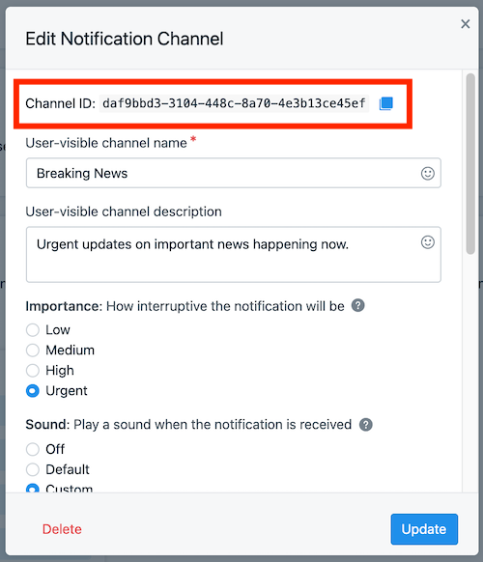
Starting from version 8.0 (Oreo), Android starts grouping notifications into different channels.
Each channel will have a specific behavior and this behavior will be applied to all notifications of that channel. Each channel has an ID that represents it.

Slide 6
02 - Parts of a notification
Notifications are important because they provide timely information and updates to users without needing to open the app.
For example, A calendar app might send a notification to remind users of an upcoming event or meeting.

Slide 7
03 - High-Priority Notification
High priority notifications demand immediate user attention and appear prominently on the device.
For example, an alarm app sends a high priority notification to wake the user up at a set time.

Slide 8
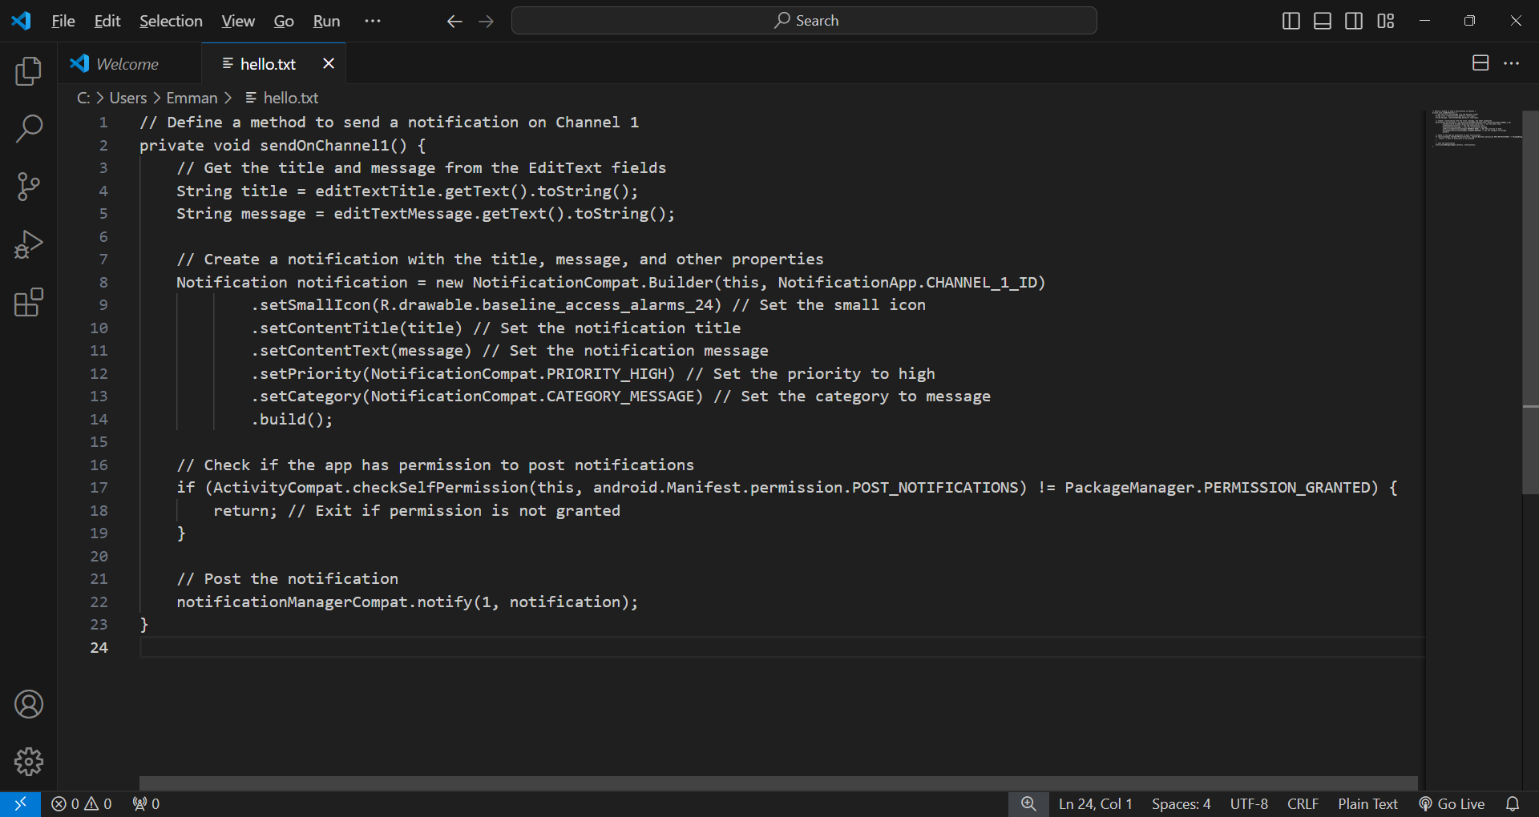
MainActivity.java for high priority

Slide 9
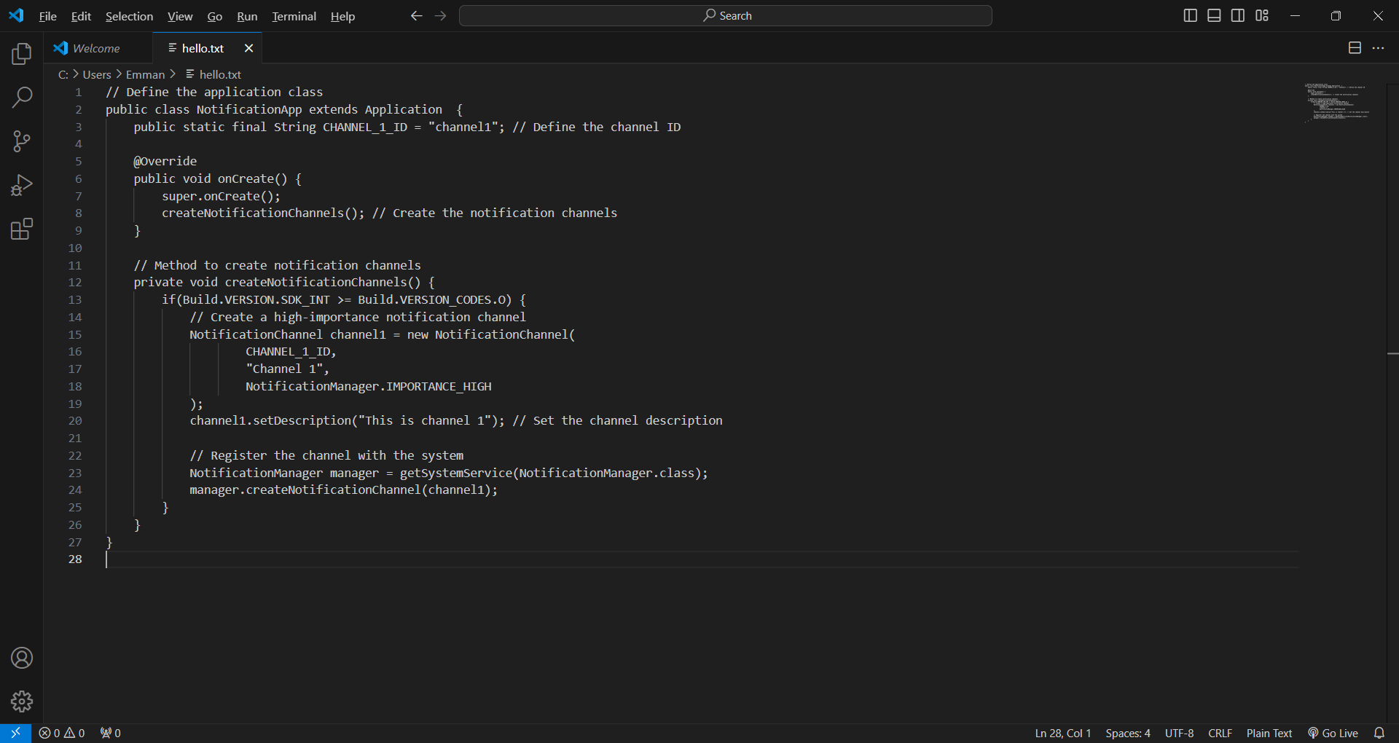
NotificationApp.java for high priority notification

Slide 10
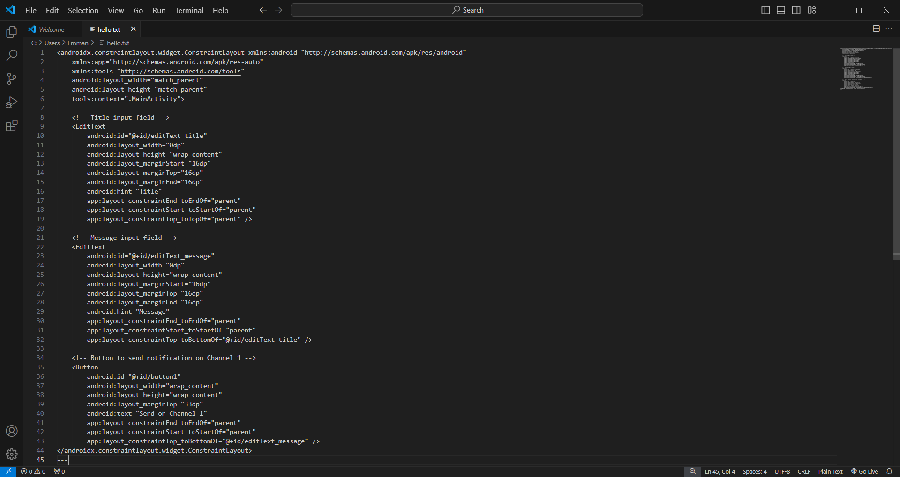
Activity.xml for high priority notification

Slide 11
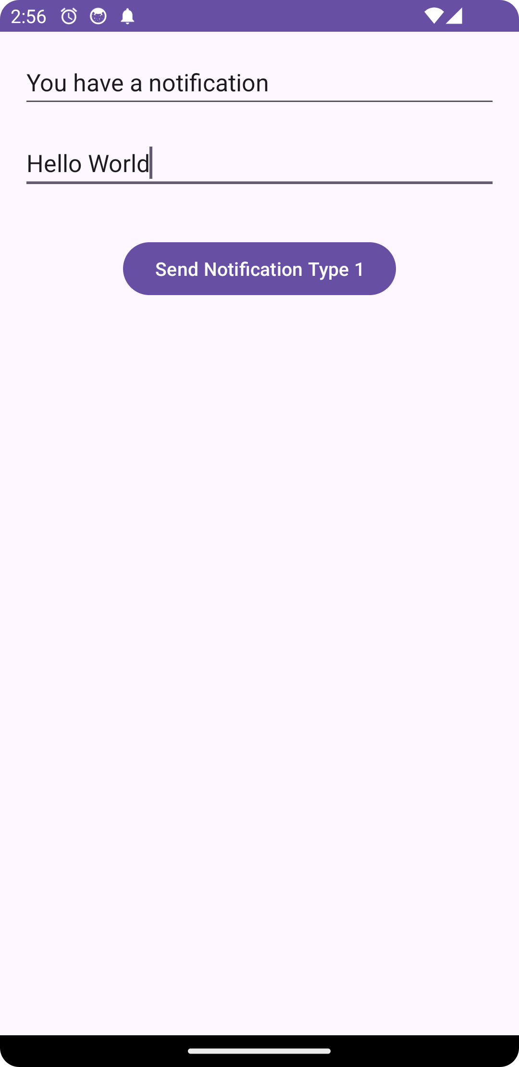
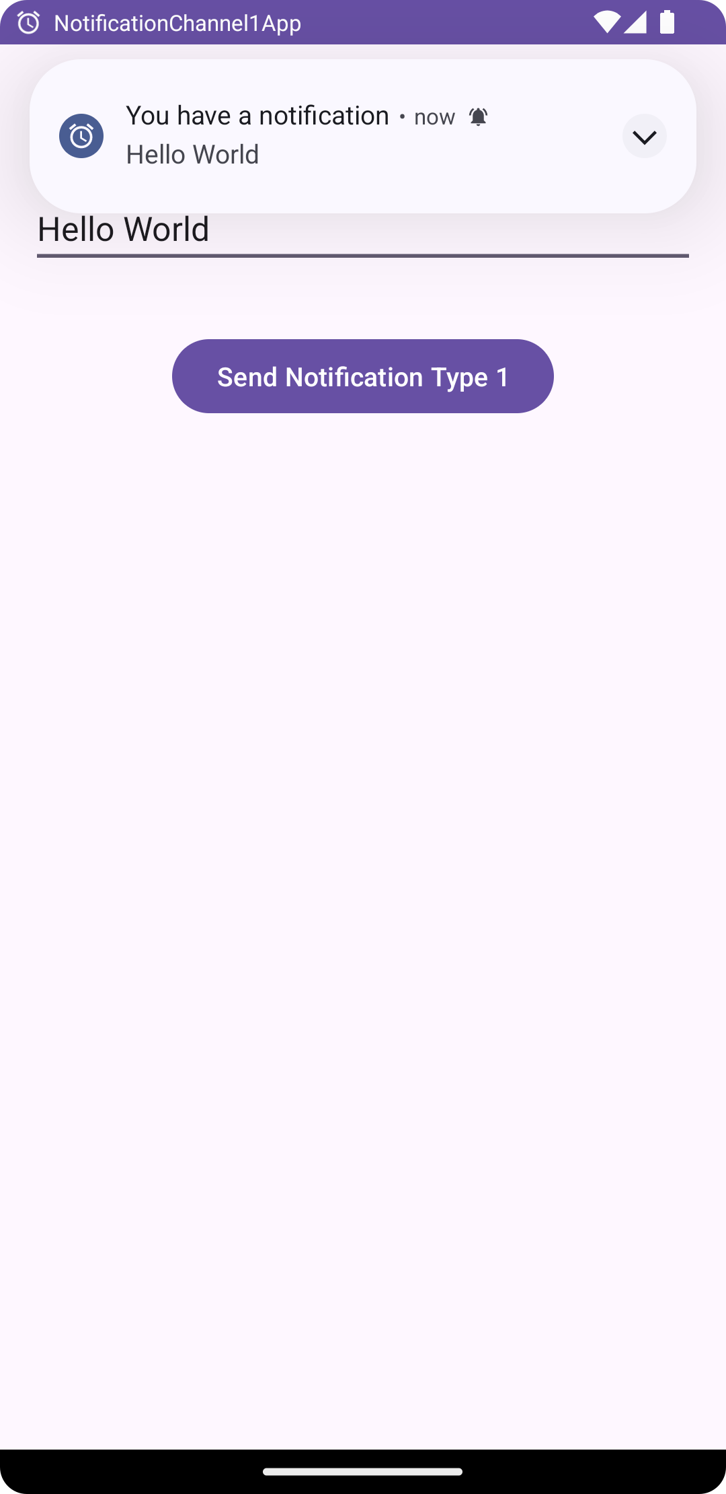
Screenshots for high priority notification

Slide 12
04 - Low-Priority Notification
Low priority notifications are less urgent and appear in a more discreet manner.
For example, an e-commerce app like Amazon might send a low priority notification about discounts or special offers that the user can view at their convenience.

Slide 13

MainActivity.java for low priority

Slide 14
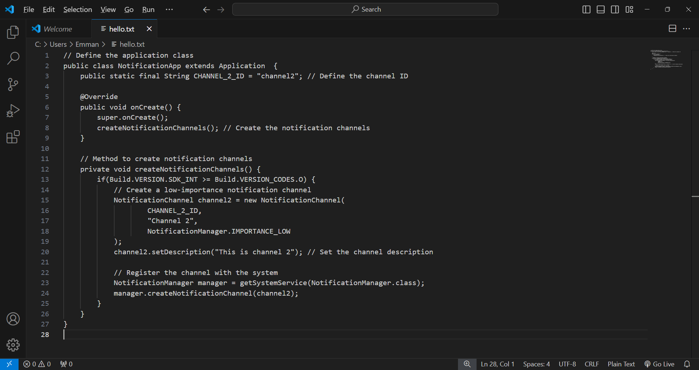
NotificationApp.java for low priority notification

Slide 15

Activity.xml for low priority notification

Slide 16
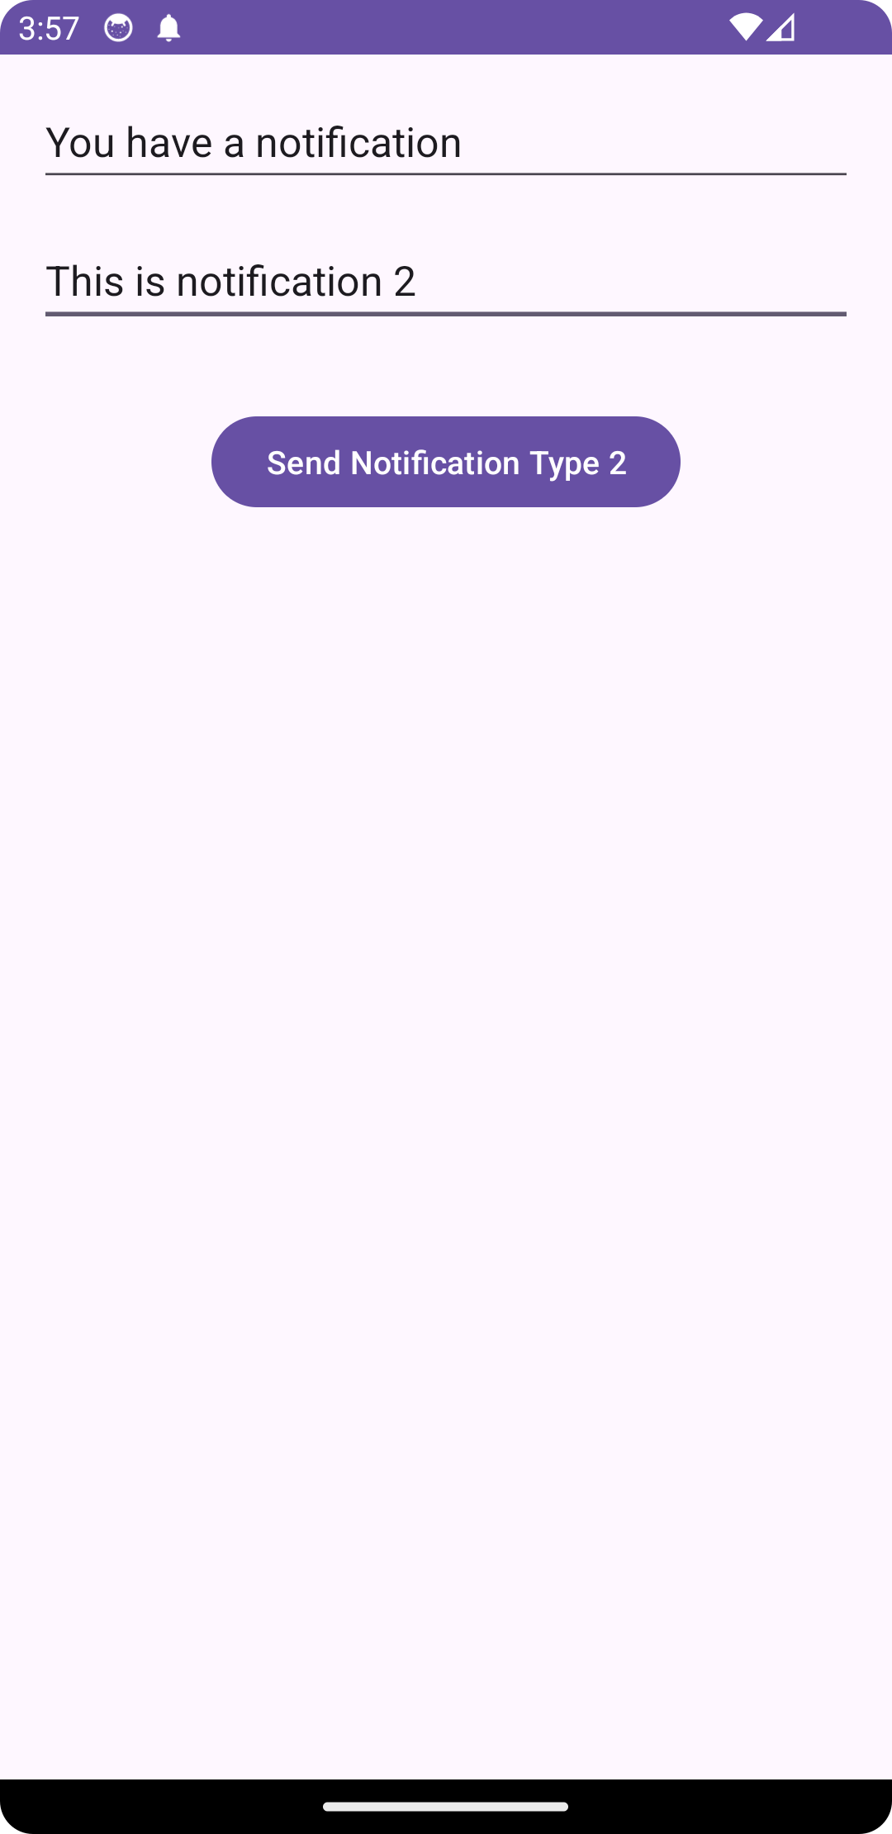
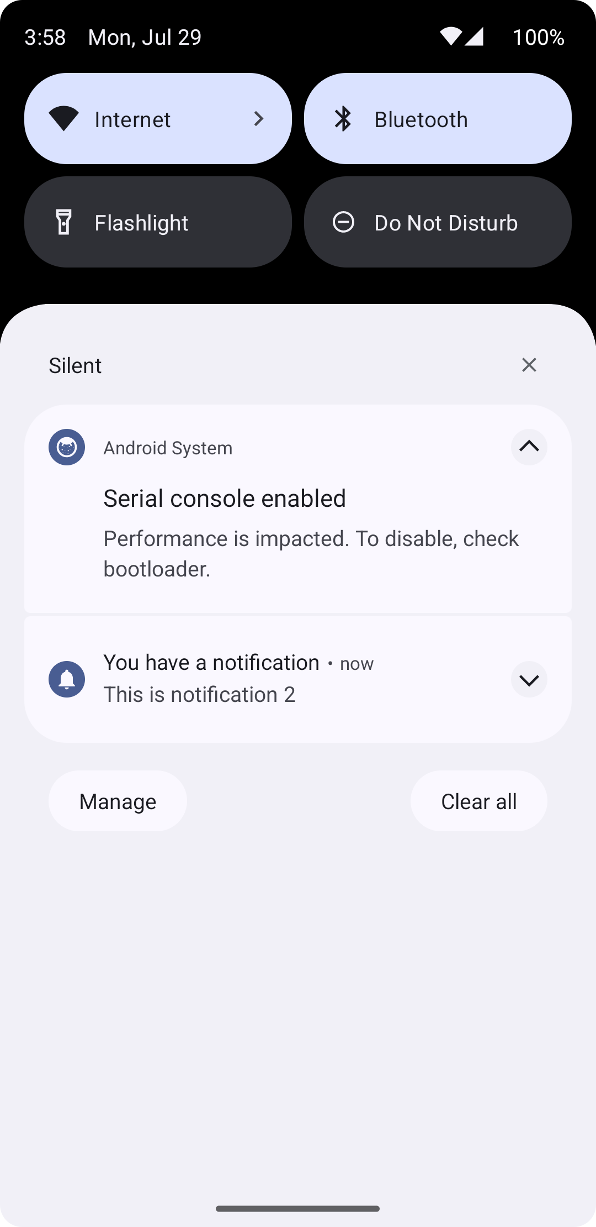
Screenshots for low priority notification

Slide 17
Demonstration
Code Breakdown
real-time preview

Slide 18
Thanks
Danke

